Slide 1
Week 6 Git Vulnerabilities Scan
Daniel 12263302 COIT11241

Slide 2
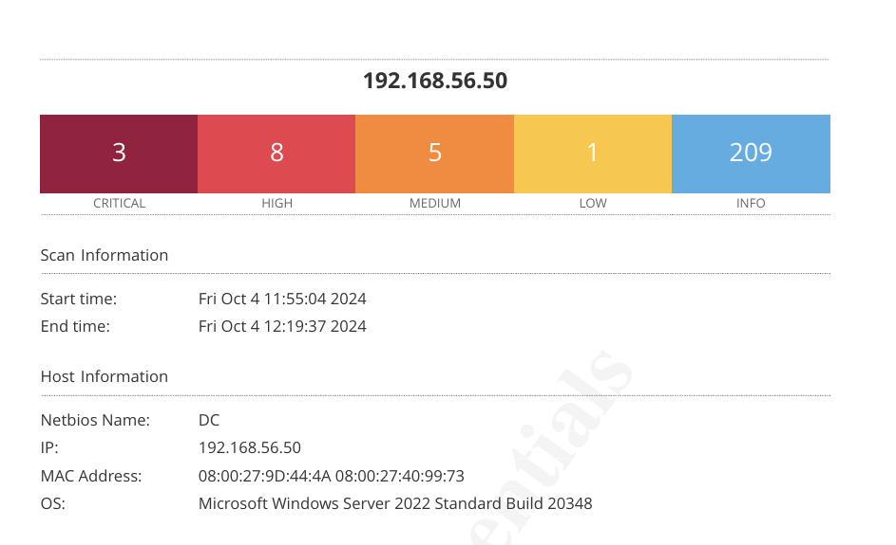
Nessus Scans
Notes:
3 Critical vulnerabilities
8 High Risks
5 medium risk
1 low risks

Slide 3
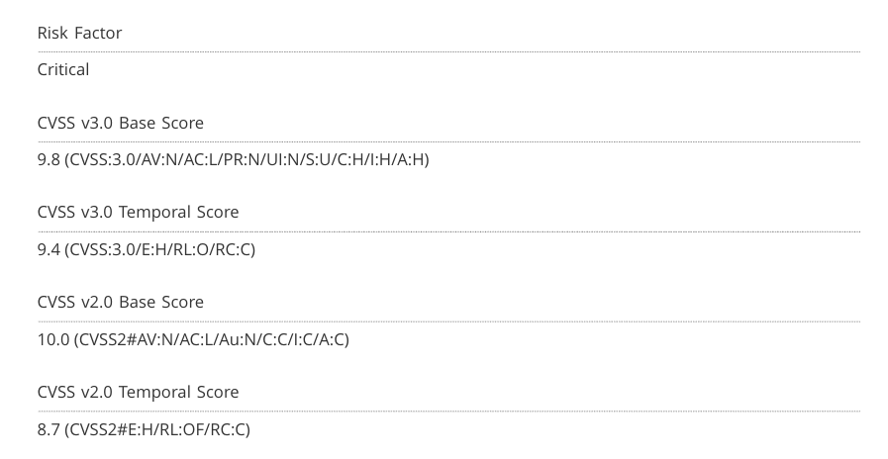

Slide 4
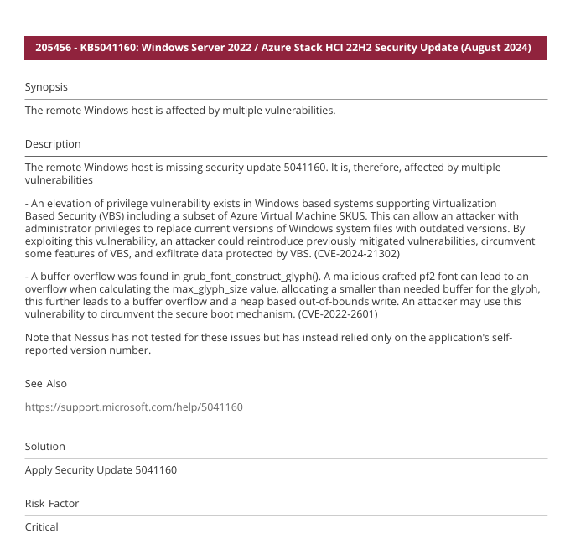
Critical Windows Server Vulnerability

Slide 5
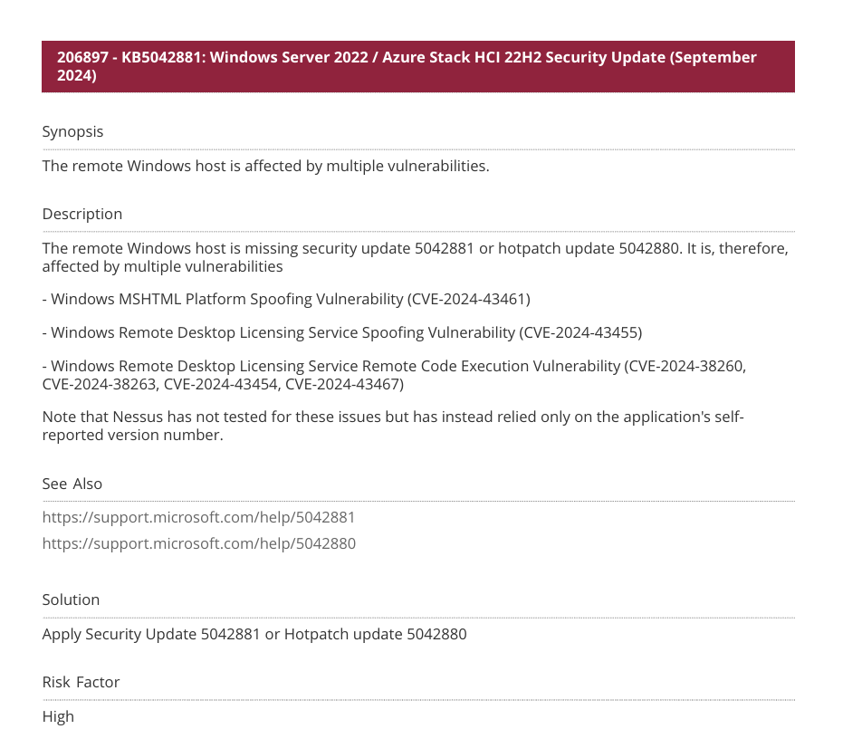
High Risk Azure Stack Vulnerability

Slide 6
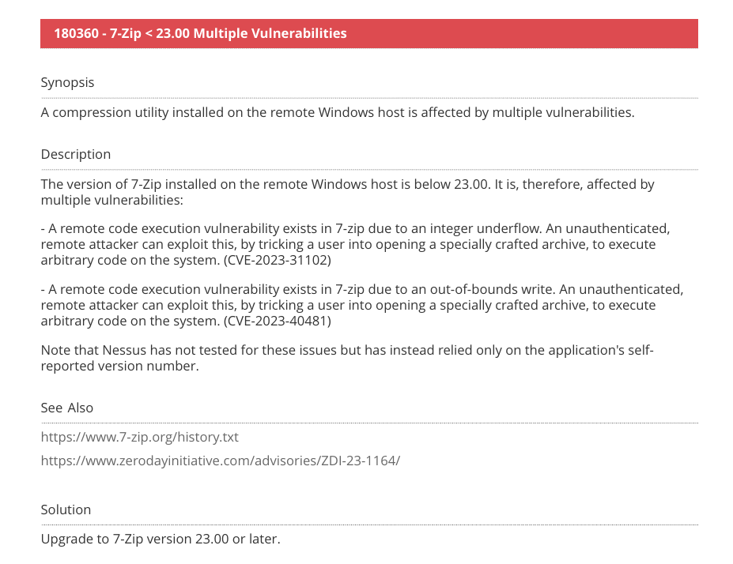
7zip vulnerability

Slide 7
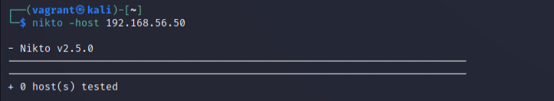
Nikto scan

Slide 8
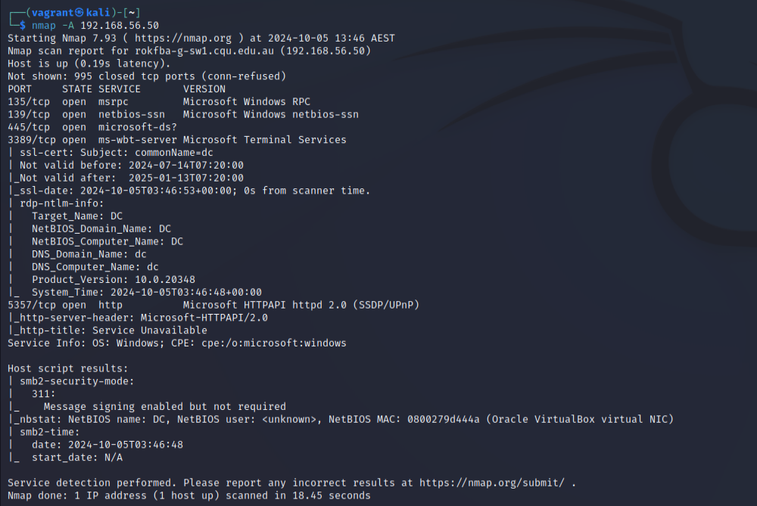
Nmap -A

